Slide 1
Word and Sentence Embeddings
Steve Aronson

Slide 2
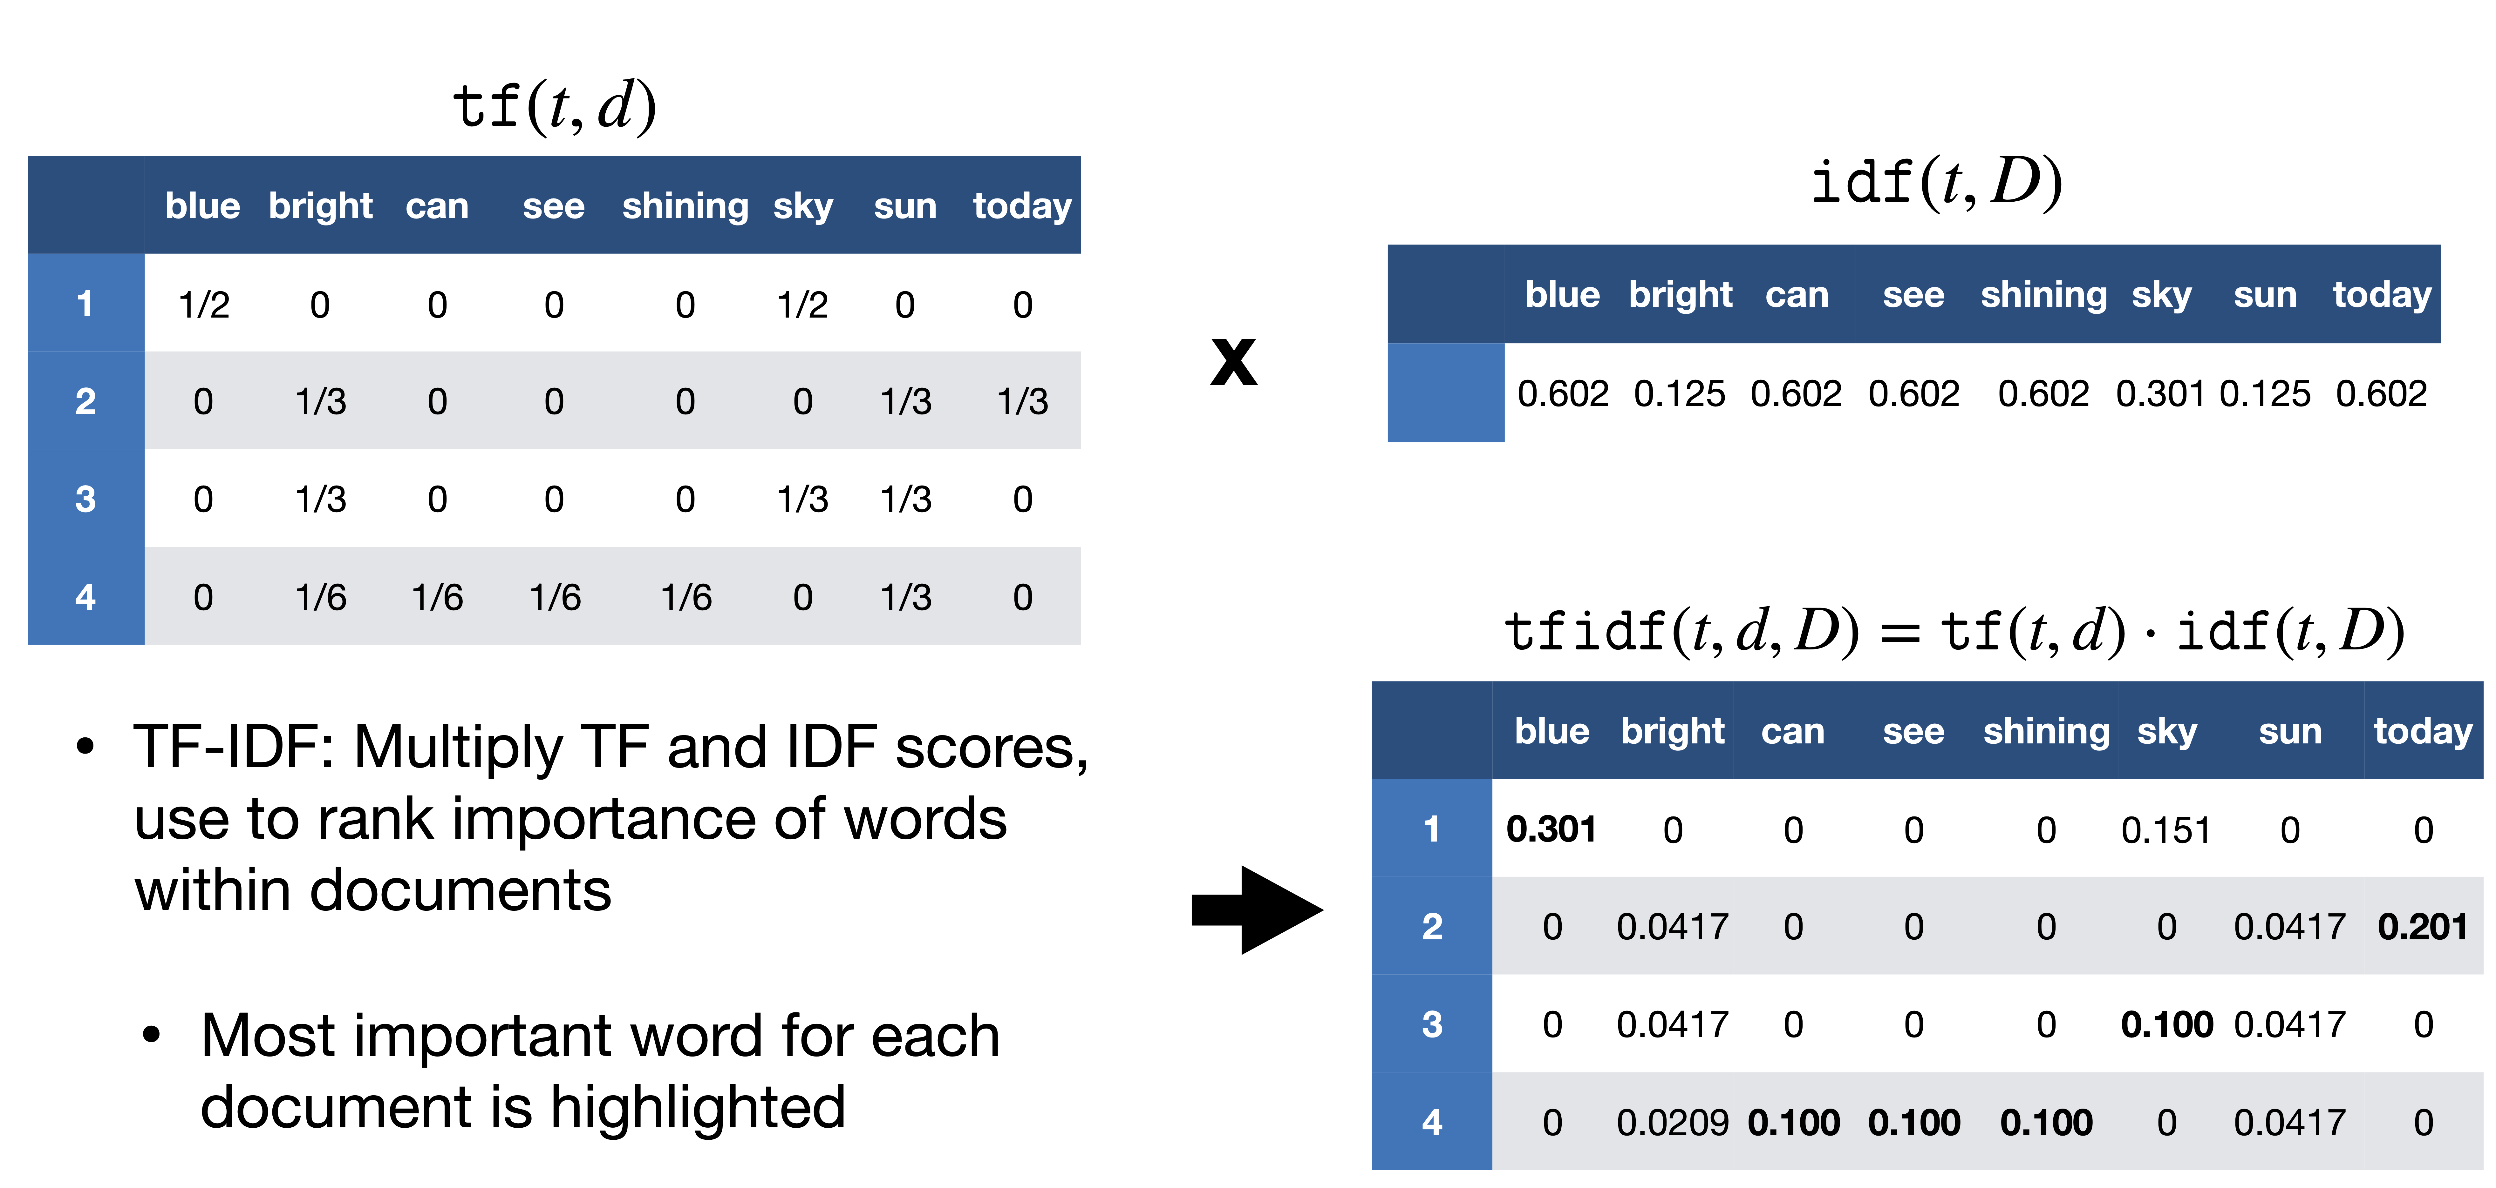
Frequency based
The sky is blue.
The sun is bright today.
The sun in the sky is bright.
We can see the shining sun, the bright sun
Vector where each element represents a different word (one-hot)
Count – sum up all one hot vectors
Term * Inverse Document Frequency (TF-IDF) – reduces value of common words
Advantages
Simple
Can limit word set to those of interest (sentiment)
Disadvantages
High dimensional
No relation between similar words

Slide 3
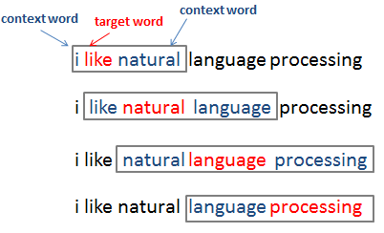
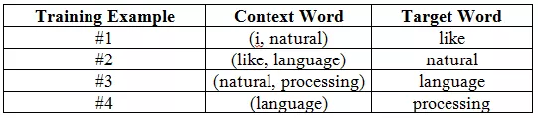
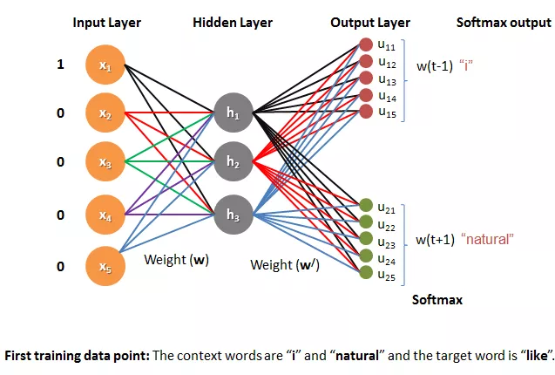
Prediction based
Model that predicts a word based on its context
Advantages
Smaller memory footprint
Vectors have relationships to each other
Disadvantages
Requires training or pre-trained
Some models cannot embed words missing from training set

Slide 4
Models
Word embeddings
Word2Vec – skip gram (picture from previous slide)
Glove
BERT - transformer
Sentence embeddings
Weighted average of words
Extensions of word prediction-based embeddings
Predict a sentence in its context
Doc2Vec (Word2Vec)
Sentence Transformer (BERT)
InferSent - Facebook

Slide 5
Pretrained Models
I chose only models that supported loading pretrained parameters
Pretraining has 2 flavors
Results only (Word2Vec and Glove)
Simple mappings between words and the embedded array
Load these into a Python dictionary (not recommended)
Key = word
Item = embedding array
Easy to use and fast
Full models with pretrained weights (SentenceTransformer and InferSent)
Pickled torch models
Encoding is simply using the model's forward method
Slow to use, but support transfer learning on your text

Slide 6
Side lessons learned
Pandas does not like to store a NumPy array into a single column
Wants to expand NumPy columns into DataFrame columns
How I resolved: convert 2D array to list of 1D arrays
Large dictionaries with list items can cause huge slow downs
Appears to be caused by Python’s garbage collection trying to track all the references
Word2Vec circumvents this with a class KeyedVectors
Uses indirection to access embeddings
Embeddings are stored as 2D NumPy array
Dictionary maps words to rows in array
Both references are fast

